Slide 1
Workbook Expenses – CoS (Historical)
Internal Use Only
April 2017
EXCEL FILE:

Slide 2
Disclaimer
The content of this workbook has been produced by KPMG Germany/Deal Advisory on the basis of German accounting standards and/or IFRS, as well as considering KPMG Germany’s firm and country requirements, regulations, processes, policies and best practices. Please check your local accounting and other requirements before applying the content.

Slide 3
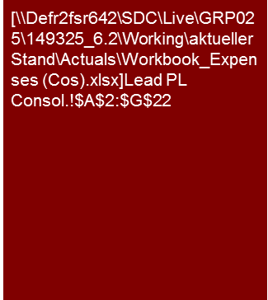
Overview (1/2)
Flag: The workbook contains examples of income statements prepared according to IFRS. Expenses are disclosed by the cost of sales method.
Benchmarking Plus tool is available in Germany. Please ask for benchmarking options in your region.
Expenses – Cost of Sales Method (historical)
Mission Statement:
Understand the trends and drivers for the costs below gross margin in the historical period.
Customer situation
Definition/Methodology/Tools of the basis analysis
Buy Side/Sell Side/JV/Turnaround
Costs below gross profit will have a significant influence on the profitability of the target entity.
Analysis of historic costs to form a view on underlying performance and respective projections in the business plan requires a thorough understanding of the relevant cost drivers.
Definition and Methodology
This workbook covers the costs below gross margin which would normally include:
Sales and distribution costs;
Administrative costs;
Research and development costs;
Other income/expenses
Interest and taxes are not part of EBIT(DA), but may be analyzed more closely in certain cases.
Especially for larger groups meaningful cost and cost driver analysis typically benefits from a drill down by Business Unit (segment), by region or by legal entity, rather that analysis of consolidated group figures only.
A key challenge for CoS analysis is typically to obtain a drill down into functional costs (selling and distribution, admin, R&D, etc.) and the respective cost drivers (e.g. own personnel/headcount, outsourced services, rent/leasing, depreciation, etc.).
General data sources:
(Monthly) management reporting and other controlling reports;
Audited financial statements;
General ledger
Degree of Standardization
Such analysis is relevant across all Deal Advisory functions and should be linked to workbooks 'Sales and Gross Profit (Historical)', 'Sales and Gross Profit (Planning)', 'Normalized Earnings” and “Provisions'.
Gathering of sector-specific KPIs (e.g. KGS Benchmarking Requests, Benchmarking Plus Tool).
Note: Expenses should be presented negative since this will help to understand the respective (sub)totals.
In order to avoid mistakes with leading signs, breakdown of cost items should also be reported negatively. For % of sales we recommend using positive signs also for cost items.

Slide 4
Overview (2/2) – Structure of analysis (Cost of Sales Format) and related workbooks
Expenses – Cost of Sales Method (historical)
High level P&L analysis
Workbooks for in-depth analyses – Value Driver Tree
Commentary
Explanation of key trends (sales growth, profitability in % of sales, significant shifts in individual P&L lines), if necessary supplemented by individual operational KPIs and/or benchmarks; depends strongly on business model and sector of the specific company
Purpose of high level P&L analysis:
Planning of our work: determine key areas of focus for detailed analyses
Reporting: Provide a Big Picture Overview on Target's financial performance and a summary of key trends observed
Workbook ”Sales and Gross Profit"
The detailed analyses should
Improve the understanding of the business model
Show the trends in financial performance (monthly or quarterly as necessary)
Identify sales and profit drivers by an appropriately detailed analysis (by product group, customer, etc.) and provide respective benchmarking
Set the basis for the Business Plan / analysis of projections (→ starting point for financial model)
Market development
Sales
x
Price
Gross Profit/ Margin
Trend analysis (with KPIs)
Volume
-
Differentiated by product groups, customers, regions (as applicable)
Margin (in % of sales)
Costs of sales
Price
By type of materials
x
EBIT
(representing entire P&L)
Volume
-
Workbook "Expenses Cost of Sales Method"
Sales and distribution costs
Analysis of personnel costs in the individual P&L blocks:
See personnel cost analysis in the total cost format workbook, (FTEs and personnel costs per FTE), however, personnel costs are not recorded within one P&L line but spread across the various cost categories
Each trend analysis must be tailored to the (sub) type of costs
Analysis aims at making cost structure and drivers transparent
Depreciation will be included within functional costs, but analysis should aim at separating the respective amounts
Expense items below gross profit
Administrative costs
Analysis of the cost structure (fixed vs. variable), benchmarking, cost driver
Other expenditures (e.g. R&D)
Workbook “Fixed assets – CAPEX"
Trend in relation to CAPEX
Impairments
Useful life and if necessary changes in accounting principles
Depreciation
Workbook “Normalized Earnings"
The goal is to understand the underlying profitability
Adjustment of historical earnings situation by “one-off effects” that are not relevant for the future development
One-off effects

Slide 5
Pitfalls and lessons learned
Expenses – Cost of Sales Method (historical)
No. | Specific analysis
 | Lack of focus on value drivers: The analyses should be focused on the major value drivers. For a pharmaceutical company for example selling costs (field force and marketing) and R&D (including respective pipeline for new drugs) will often be more relevant than sales and margin analysis, whereas for a 2nd or 3rd tier automotive supplier selling costs may effectively be limited to shipping costs, and for R&D the key focus may be on how development costs are subsidized by OEMs and respective accounting.
 | Inconsistencies compared to the Business Plan: Format: Often we have to work with different data sources for historic and protected financials (e.g. annual report versus controlling data). This can cause problems for our (like for like) trend analysis unless we perform a consistent mapping of line items over the entire period (e.g. presentation of sales discounts and rebates as a deduction of sales or as part of selling expenses). Therefore you should familiarize yourselves with the business plan format before you start detailed historic analysis. Recurring: Expense analysis should aim at establishing a recurring level for each type of expenses (a robust base year to be used as a starting point fort the business plan analysis). Whenever we come across significant one-off effects (→ “Normalized Earnings” workbook) we should consider to adjust our historic cost analysis on a line by line basis (rather than only presenting the net EBITDA effect of adjustments). This is typically most prominent for other income, simply because the recurring level of other income is generally low, so that even small distortions by non-recurring income items will be highly visible).
 | Lack of sufficiently detailed cost information: A key challenge for CoS cost analysis is typically to obtain a drill down into e.g. selling costs (e.g. own personnel/headcount, outsourced services, advertising spend, etc.). Without such drill down, however, it will be almost impossible, to properly understand and analyze the respective cost drivers, but even if we cannot perform quantitative analysis we should at least obtain a qualitative understanding of respective cost drivers and trends. For large groups, a drilldown may by legal entity / reporting unit may be a second best option to obtain at least some granularity (but be mindful of intercompany charges, e.g. for group marketing, which may impact such legal entity view).
 | Lack of focus on current trading figures: Analysis of current trading information is often left until shortly before issuing a report, and then presented in a separate report section. The benefit is that we do not need to update the entire report for most recent numbers, and that we can accommodate the typically lower granularity of current trading figures compared to annual reporting. However, for relevant cost items we should enquire into most recent trends to double check our understanding regarding the respective cost drivers and trends.
 | Unsuitable benchmarks: Benchmarking is extremely valuable to challenge our understanding of a company’s business model and cost drivers. However, we need to understand relevant differences between companies in the peer group, e.g. regarding the capitalization of development costs.
1
2
3
4
5

Slide 6
Core issues (1/2)
Expenses – Cost of Sales Method (historical)
Core Issue | Specific analysis | Page(s)
What are the primary costs (and the respective cost drivers) ? | Prior to any in depth analysis of specific functional cost items rank them by magnitude and consider their impact on bottom line profitability. For example if selling expenses have historically been at a more or less constant percentage of sales, and there is no indication that this will change in the coming years, we should not spend much time on respective analysis, unless there is specific reason (e.g. expected synergies). Align the structure of historic cost analyses to the Planning workbook, i.e. what drivers are used in the Business Plan to drive the cost base, to what extent are admin costs (selling/marketing, R&D and other respectively) mapped to Business Units and do we see major changes to specific costs in the Business Plan. | 8-11
Trends and cost drivers Do costs increase proportionally to sales? (How) will the cost structure change going forward and what are the implications on the valuation and the business plan? | A key problem of cost analysis following the cost of sales method is to drill down into functional costs and the respective cost drivers (e.g. own personnel/headcount, outsourced services, rent/leasing, depreciation, etc) to a level that will allow us to challenge planning assumptions in the Business Plan analysis The challenge will often be to supplement a CoS view by Total Cost Method type of analysis, e.g. personnel costs with in selling and respective drill down into headcount and pay levels; or especially for R&D to obtain a breakdown of costs by R&D projects | 8-11
Supplementary cost by nature analysis and respective trends; e.g. for total personnel expense or total depreciation Can cost by nature analysis provide additional insights even if respective costs cannot be (exactly) mapped to functional costs? What are key trends in such costs going forward and what are the implications on costs by function the business plan? | Even if a breakdown of functional costs into personnel, depreciation, etc. may not be feasible, it may be possible to analyze such cost in total (i.e. total personnel costs or total depreciation). In that case we would effectively perform Total Cost Method type of analysis (refer respective workbook) in parallel to CoS type of analysis | See workbook expenses – total cost method (TCM)

Slide 7
Core issues (2/2)
Expenses – Cost of Sales Method (historical)
Core Issue | Specific analysis | Page(s)
Seasonality and volatility of the cost development during the year Are seasonality patterns recognizable (and therefore predictable)? Do costs fluctuate on a monthly basis and, if yes, why? | (Monthly) trend analysis and seasonality charts. In case of fluctuating costs: Compare costs to sales seasonality. Discuss with management whether costs are properly accrued on a monthly basis. In case of poor month end 'cut-off' quality consider quarterly instead of monthly trend analysis (if quarterly cut-off is more robust). Underlying trend analyses: Moving averages (e.g. LTM = last twelve months) or growth rates compared to same period of prior year can be helpful particularly in case of seasonal businesses. | n.a. (best practice examples welcome)
YTD trading compared to budget/ previous year Implications on the planning process (see Planning workbook) | Comparison of current trading to budget and previous year. Gap analysis to financial year / prior year figures (as a percentage of full year / previous year ratio). LTM analysis. Rolling forecast. | n.a. (best practice examples welcome)
Assessment of the cost structure compared to competitors; is there any potential for a reduction in the cost base? | KPIs of peer group companies (benchmarking) – make sure you compare ‘apples with apples’ and bear in mind that e.g. accounting principles (opex vs. capex) and/or the cost allocation to P&L line items may be different (e.g. FY gains/losses in selling, in admin, or separately in ‘other’). Identify, analyze and explain possible deviations from market expectations (e.g. accounting, scale effects, etc.). | n.a. (best practice examples welcome)
Related party transactions (carve out situations) What deliverables/services does the company provide/receive for/from the group? What is planned going forward? How is transfer pricing carried out and (how) will it change in the future? How do the corresponding "standalone" changes impact cost items? | In a CoS Format P&L analysis the key question regarding the impact intercompany transactions below gross profit is to what extent central group activities were charged to business units and on what basis Presentation of the major intragroup services (table or i/c value flows). Description of the respective ‘transfer pricing’ (i.e. the basis for pricing of such group charges). Comments on changes of transfer pricing in the past and effects expected going forward. Financial analysis should cooperate with tax analysis, as tax regimes typically require formal documentation of group charges, which can be helpful for financial analysis. | n.a. (best practice examples welcome)

Slide 8
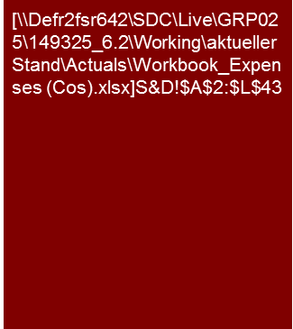
Example analysis – Sales & distribution costs
Expenses – Cost of Sales Method (historical)
S&D costs are dominated by personnel costs (rather fixed cost) and group charges and cost allocations for services by group sales entities (included in "other costs", fluctuations due to changes on group level regarding the sales organization and respective cost allocations).
For personnel costs the key driver going forward should be expected to be pay rises, since management sees little room for further headcount reduction.
Going forward group charges will largely be replaced by own personnel expenses and TSA costs (refer Business Plan section).
Group Charges:
If, as in this this “carve-out" example, group charges are a material cost driver, these should be analyzed separately.
The analysis should rather focus on any implication in a stand alone scenario rather than the appropriateness of the group charges itself.
Reduction of own sales headcount in 2012
High-level of warranty/quality costs in 2010 caused by two specific issues, which have been solved
Historical fluctuations mainly due to group charges.
Stand alone cost and required TSAs to be discussed as part of the business plan
Impacted by sales trends in combination with rather fixed personnel cost; and in addition fluctuations in group charges.
Source: Management information; KPMG analysis
Favorable mix effect on average pay per head as headcount reduction affected highly paid sales personnel in Germany.
Pay attention:
Availability/Quality of data:
In case breakdowns are not available (which is often the case), it is important to focus what analysis can be made with the data available.
In case a breakdown by into cost subcategories is not available, a breakdown into costs by company/country may be helpful. The analysis should then be limited to a few countries, otherwise it will become too detailed (especially in case costs are classified differently within the group).
Note:
Analyzing and presenting a breakdown of “sales and distribution costs” into its sub-costs has the following reasons:
Understanding the cost drives , e.g. freight & packaging developing in line with sales, personnel expenses being semi-fixed costs in nature, marketing costs depending on campaigns or trade fairs, etc.
Making extraordinary effects obvious (here warranty cost in 2010).
Understanding what is the line items actually contain in order to compare like with like

Slide 9
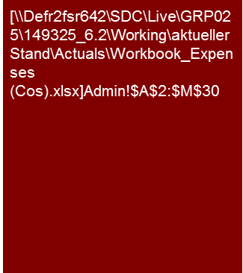
Example analysis – Administration costs
Expenses – Cost of Sales Method (historical)
The key driver for administration costs are personnel expenses and group charges.
Admin personnel headcount was driven by a temporary decrease in 2011 (restructuring did not prove sustainable). Pay rises added to the cost increase in 2012.
Group charges (included in "IT" and "other costs") include lump-sum charges for allocated corporate and HQ costs. Target expects significantly lower costs for a stand alone organization (to be discussed as part of the business plan).
Group Charges:
If, as in this this “carve-out" example, where the Target was part of a larger Group, group charges are a material cost driver (and have caused fluctuations in respective cost line items) , these should be analyzed separately.
The analysis should rather focus on any implication in a stand alone scenario rather than the appropriateness of the group charges itself.
Combination of
lower IT group charges in Germany; and
Re-allocation of IT expenses within the P&L of the US subgroup (until 2011 entirely reported within Admin, since 2012 allocated across all functional cost categories including cost of sales)
In addition the 2011 cost had been impacted by one off costs related to a SAP roll out in major entities
Source: Management information; KPMG analysis
Change in group charge cost allocation following a reorganization on group level
Swing back of headcount as prior year restructuring proved not sustainable. In addition general pay rises

Slide 10
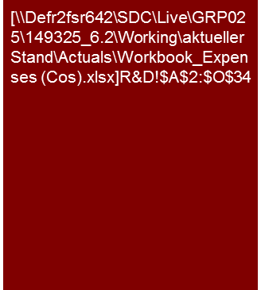
Example analysis – Research & development costs
Expenses – Cost of Sales Method (historical)
R&D costs show an average level of slightly above 7% of sales.
The key measure historically taken to manage R&D cost was to close a R&D center in Northern Europe (high labor costs) with respective activities largely transferred to existing R&D centers in Germany.
In addition management has recently started to build up own R&D in China (and has in 2010 used short time work arrangements in Germany to temporarily reduce personnel cost).
Linking of the R&D costs with R&D projects:
An analysis of R&D costs by cost category (e.g. Personnel, external research, etc.) is often sufficient in case R&D activities consists of several smaller projects.
However, as soon as basic research, extensive product innovations or large individual research projects are made, the cost analysis should be linked to the corresponding research projects (R&D budget for the project, timeline, expected benefit).
The corresponding analyses must be designed and conducted for the individual company.
Short time work arrangement in Germany.
Reduction primarily reflects closing of an R&D center in Northern Europe (which was jointly operated with another group company)
The respective R&D functions were transferred to other existing sites.
Source: Management information; KPMG analysis

Slide 11
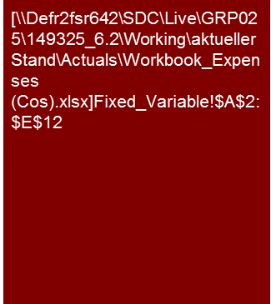
Example analysis – Fixed vs. variable costs analysis
Expenses – Cost of Sales Method (historical)
Based on management's assessment, approximately 45% of the total 2012 cost base is considered fixed (i.e. can hardly be changed within a time horizon of one year).
This qualitative assessment broadly corresponds with cost trends observed from 2011 to 2012.
Note:
A ‘contribution margin’ P&L format, as typically used for controlling reports, may provide better insights into fixed versus variable costs.
However, it will be very difficult to map such ‘contribution margin’ analysis to the "normal" P&L (as reported under IFRS) and investors typically prefer to have all analysis focused on and reconciled to IFRS reporting.
Source: Management information; KPMG analysis

Slide 12
© 2017 KPMG International Cooperative (“KPMG International”). KPMG International provides no client services and is a Swiss entity with which the independent member firms of the KPMG network are affiliated.

